Slide 1
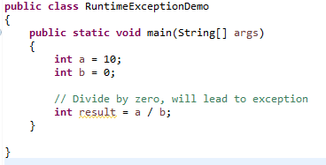
Runtime Exception
When we don't handle the exceptions, they lead to unexpected program termination. Lets take an example for better understanding.
This will lead to an exception at runtime, hence the Java run-time system will construct an exception and then throw it. As we don't have any mechanism for handling an exception for this program, hence the default handler will handle the exception and will print the details of the exception on the terminal.
Name and description of the Exception
Stack trace.(line at which exception occurred)
Class name
File Name

